Slide 1
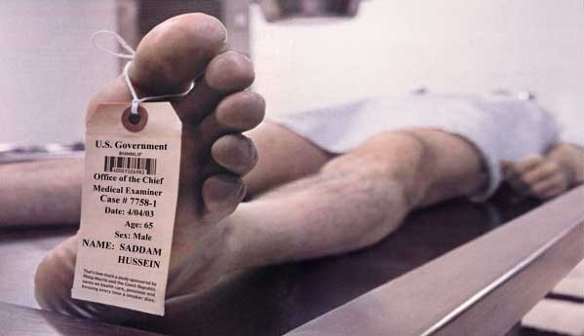
Lecture 6.2 – Logarithms and ph

Slide 2
Learning Targets
6.4 – I can identify a compound as an acid or base using the pH of a solution.
6.5 – I can calculate the pH of a solution and explain whether this compound is acidic or basic.

Slide 3
How do you calculate logarithms?

Slide 4
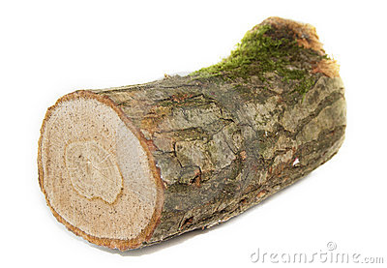
I. Logarithms
Logarithms are used to represent large numbers
A general logarithm can be written as:
log_{b}x=y
b = base.
This can be translated to exponetial form by:
b^{y}=x

Slide 5
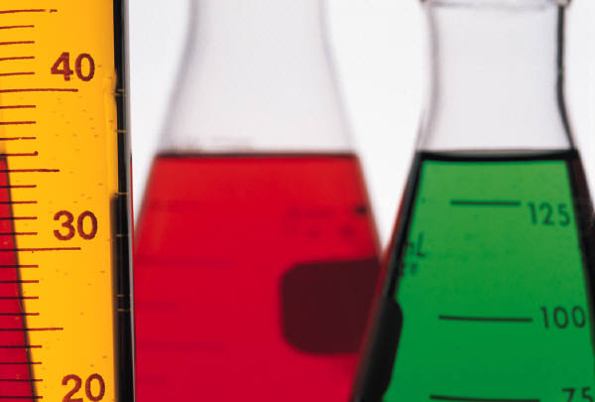
Class Example
log₅25=?

Slide 6
Table Talk
log₃27=?

Slide 7
Stop and Jot
log₁₀1000 =

Slide 8
IMPORTANT
If you don’t have a base on your log, then your base is 10

Slide 9
How are logarithms used to calculate pH?

Slide 10
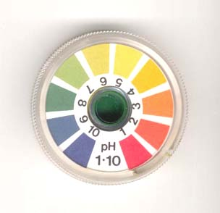
I. pH
The concentrations of acids and bases are often very low.
We use the pH scale to convey the concentration of H⁺
The pH scale is 0-14.
Acid = pH 0-7
Base = pH 7-14
Neutral chemicals = pH of 7.

Slide 11
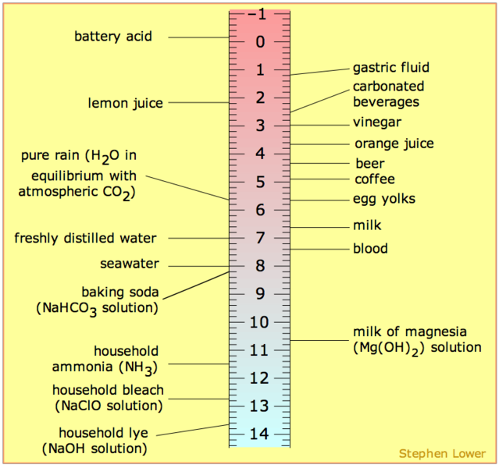

Slide 12
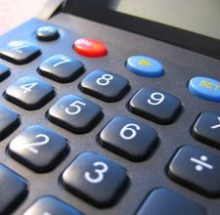
II. Calculating pH and pOH
p(anything) means -log(anything)
So, pH means -log(H⁺).
We calculate the pH by:
pH=-log(H⁺)
We calculate pOH by:
pOH=-log(OH⁻)

Slide 13
Table Investigation
We did logs of nice whole numbers, but our molarities are normally decimals. What is the trend that you notice for the following logs:
log(0.1)= -1
log(0.01)= -2
log(0.001)= -3
log(0.0001)= -4
log(0.00001)= -5

Slide 14
III. Calculating pH
We only will calculate the pH for strong acids/bases.
A strong acid/base completely dissociates.
This means that if we have a 0.1 M solution of HCl, then [H⁺]=0.1 M

Slide 15
Class Example
Calculate the pH of a 0.01 M solution of H₂SO₄

Slide 16
Table Talk
Calculate the pH of a 0.001 M solution of HCl

Slide 17
How are logarithms used to calculate pOH?

Slide 18
I. Calculating the pH of a Base
A strong base completely dissociates.
This means if we have a 0.1 M solution of NaOH, then we have [OH⁻]=0.1 M
Can now calculate the pOH
Once we have the pOH, we calculate the pH by:
pH=14-pOH

Slide 19
Class Example
Calculate the pH of 0.01 M solution of KOH

Slide 20
Table Talk
Calculate the pH of a 0.0001 M solution of Ca(OH)₂

