Slide 1



Lecture 2.5 – Electronegativity

Slide 2
What is electronegativity?

Slide 3


I. Electronegativity
Electronegativity is the measure of the ability of an atom to attract electrons.

Slide 4
What are the trends for electronegativity?

Slide 5
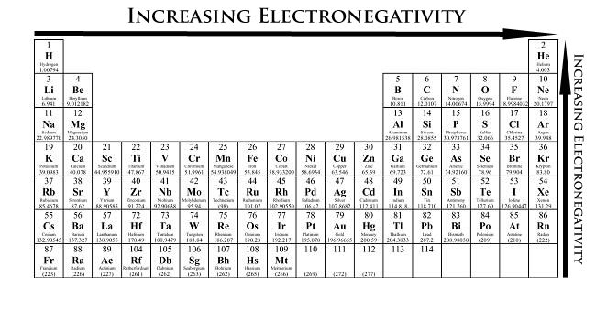
I. Electronegativity Trends
As you go down a group, the electronegativity decreases.
As you go across a period, the electronegativity increases.

Slide 6
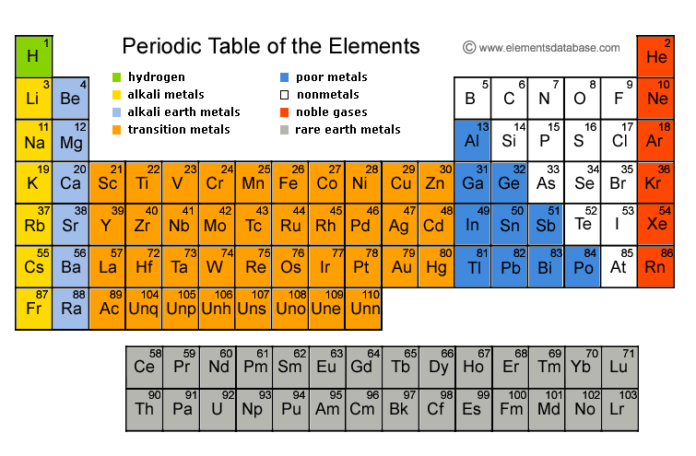

Slide 7
Notes:
Se, Ni, Ca
Po, S, O
Cs, Ga, F

Slide 8

Class Example
Order the elements from smallest to largest electronegativity: oxygen, beryllium, lithium,
Notes:
Li, Be, O

Slide 9

Table Talk
Order the elements from largest to smallest electronegativity: chlorine, bromine, fluorine
Notes:
Br, Cl, F

Slide 10

Stop and Jot
Order the elements from smallest to largest electronegativity: silicon, aluminum, sulfur
Notes:
Al Si, S

Slide 11
Why do these trends exist?

Slide 12
I. Why Electronegativity Decreases Down a Group
As you go down a group more orbits are added.
Electroneg. decreases because there is a decreased ability of the nucleus to attract electrons because of larger distance.

Slide 13
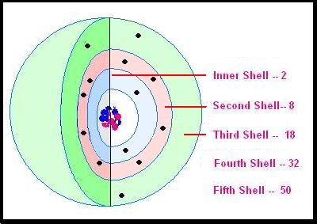
II. Why Electronegativity Increases Across a Period
As you move across a period you add more protons and electrons within the same orbit.
The larger amount of protons in the nucleus and electrons in orbit show an increased attraction, which leads to increased electroneg.

