Slide 1


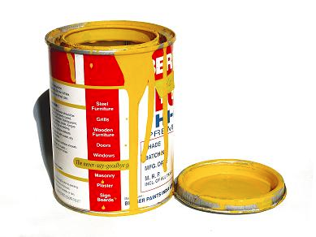
Lecture 1.4 – Electron Configurations and the Octet Rule

Slide 2
What is the Octet Rule?

Slide 3
I. The Octet Rule
Atoms like to have a full outer valence shell
They will gain or lose electrons to have an outer orbit with 8 electrons (or 2 if it is the first energy level).
Gain/lose based on what is easiest.

Slide 4

Class Example
Draw the Bohr electron configuration for beryllium after it has satisfied the Octet Rule.

Slide 5

Table Talk
Draw the Bohr electron configuration for magnesium after it has satisfied the Octet Rule.

Slide 6

Stop and Jot
Draw the Bohr electron configuration for calcium after it has satisfied the Octet Rule.

Slide 7

Octet SHORTCUT!
All elements in the same group, gain/lose the same number of valence electrons.

Slide 8
What are the types of ions that can form?

Slide 9
I. Ions
When atoms gain/lose electrons, they gain a charge.
Ion – An charged atom due to unequal number of protons and electrons
Cation – A positively charged ion
Anion – A negatively charged ion

Slide 10
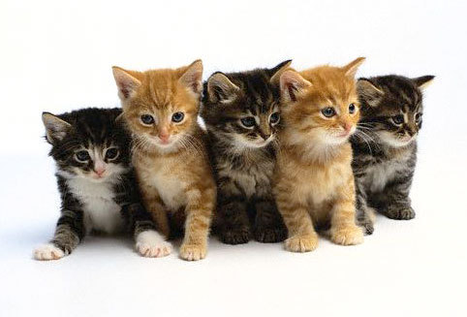
Cats make people feel positive
Notes:
Way to remember the difference between a cation and an anion.

Slide 11
Class Example
Determine the ion that forms for fluorine after the Octet Rule has been satisfied.

Slide 12
Table Talk
Determine the ion that forms for nitrogen after the Octet Rule has been satisfied.

Slide 13
Stop and Jot
Determine the ion that forms for oxygen after the Octet Rule has been satisfied.

Slide 14
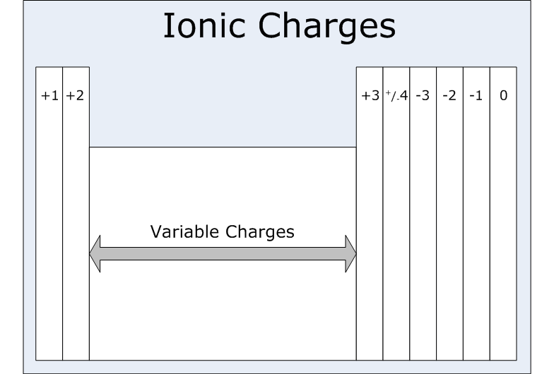
Ion Shortcut!
All elements in the same group, form ions with the same charge.

