Slide 1


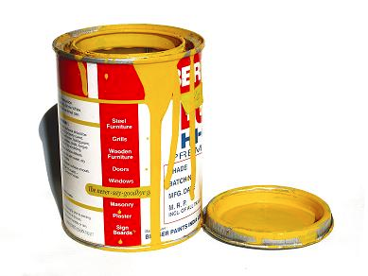
Lecture 1.4 – Electron Configurations and the Octet Rule

Slide 2

Today’s Learning Target
LT 1.4 – I can determine the number of valence electrons for an element, draw a Bohr electron configuration for an element and explain how the Octet rule leads to the formation of ions.

Slide 3
How do you draw Bohr diagrams?

Slide 4

I. Essential Point
Atoms do not have a charge
Neutral atoms have equal numbers of protons and electrons.
So, atomic number also tells us the number of electrons.

Slide 5
II. Periodic Table Nomenclature
Groups – Vertical columns on the Periodic Table
Periods – Horizontal rows on the Periodic Table
Periods Push Across
Groups Go Down

Slide 6
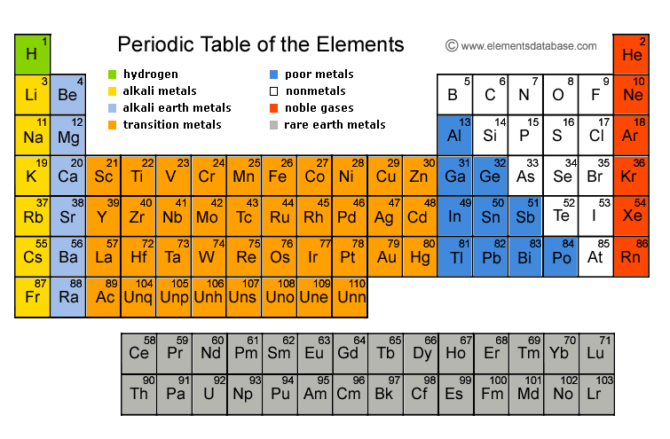

Slide 7
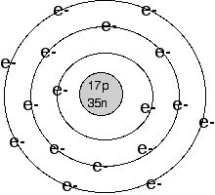
Bohr Model of the Atom
Notes:
Ask a student to remind you what the Bohr model of the atom stipulated. How was this different from Rutherford’s and Thomson’s model of the atom?

Slide 8

III. Electron Orbits
The first orbit holds 2 electrons
Every other orbit after the first orbit holds 8 electrons.

Slide 9
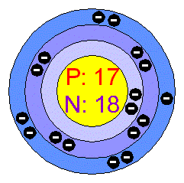
IV. Valence Electrons
Valence Electrons – The number of electrons that are in the outermost electron orbit

Slide 10

Class Example
Draw the Bohr electron configuration for lithium. Determine the number of valence electrons.

Slide 11

Table Talk
Draw the Bohr electron configuration for sodium. Determine the number of valence electrons s.

Slide 12

Stop and Jot
Draw the Bohr electron configuration for potassium. Determine the number of valence electrons.

Slide 13

SHORTCUT!
All elements in the same group (1A, 2A, etc.) have the same number of valence electrons.

